Slide 1

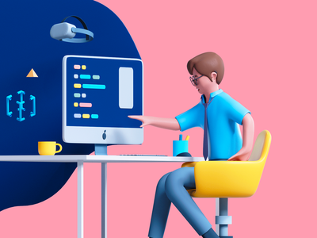
Human Computer Interface
Lecture By: Syed Nawaz Pasha
Assistant Professor
CS&AI
Class: CSE-II/I

Slide 2

Course Outcomes
Analyse models on user centric design process and test the appropriateness of individual methods for a given problem.
Learn information gathering and usage of tools for analysis and user requirements.
Implement interaction design basics and associated design rules.

Slide 3
Course Evaluation Components
Components of Course Evaluation | Percentage
Mid-Term | 20
End Term Examination | 40
Continuous Lab Evaluation | 20
Lab Exam | 10
Certification | 10

Slide 4
Text Books
Wilbert O. Galitz, The Essential Guide to User Interface Design: An Introduction to GUI Design Principles and Technique (2nd ed.), John Wiley &Sons, 2007.
Dix, J. Fincay, G. D. Abowd, and R. Beale, Human Computer Interaction (3rd ed.), Pearson Education, 2003.
S. Lauesen,, User Interface Design: A Software Engineering Perspective (1st ed.), Addison-Wesley, 2004.

Slide 5
Let me run through the syllabus
Open the word document and display…

Slide 6
Introduction
Let us learn the terms
Human
Computer
Interaction

Slide 7
Human
Perceives information through senses
Seeing
Hearing
Touch
Smell and
Taste
Human=senses+memory+skill+knowledge
Note: In HCI we have to take into consideration every element of human.

Slide 8
Computer
Electronic device that performs some task
Input→computer(processes)→Output
A computer can be anything like mobile device or tablet or pc or augmented reality or virtual reality.

Slide 9
Interaction
Human----------------→Computer
Or Computer---------→Human
Human+computer--→Task

Slide 10
HCI vs User interface Design
HCI(Human Computer Interaction):
It is the study of how people and computer work together so that person’s need are satisfied in the most effective way.
User Interface Design:
It is a subset of HCI
“Goal of Designer is to help the user feel like they are interacting directly with the task rather than interface”

Slide 11
Tips to do well in HCI Course
Leave behind what you know..
Participate.
Select an application to reflect.
Don’t assume.

Slide 12
Conclusion
Where ever computer is there, “there is HCI”.
HCI is ubiquitous.
The goal of HCI is the make the interaction between user and computer efficient.

Slide 13
Applications of HCI
Education
Healthcare
Virtual Reality
Augmented Reality
Gaming
Robotics
Mobile
CSSW(Computer Supported Cooperative work)
Information Visualization.
Security

Slide 14
Syllabus Unit-I(Text Book-I)
The User Interface – An Introduction and Overview
Importance of User Interface
Defining the User Interface
Importance of Good Design
Benefits of Good Design
A Brief History of the Human – Computer Interaction
A Brief History of Screen Design
Characteristics of Graphical and Web User Interfaces
The Graphical User Interface
The Popularity of Graphics
The Concept of Direct Manipulation
Graphical System : Advantages and Disadvantages
Characteristics of the Graphical User Interface
The Web User Interface
The Popularity of the Web
Characteristics of a Web Interface
The Merging of Graphical Business Systems and the Web
Characteristics of an Intranet versus the Internet
Principles of User Interface Design
Principles for the Xerox STAR
General Principles

Slide 15
The User Interface – An Introduction and Overview
User interface design is a subset of the field of study called Human – Computer Interaction (HCI).
HCI is the study, planning and design of how people and computers work together so that a person’s needs are satisfied in the most effective way.

Slide 16
Factors to be considered while designing HCI
HCI designers must consider a variety of factors:
What people want and expect
What physical limitations and abilities people possess
How their perceptual and information processing systems work
What people find enjoyable and attractive
Technical characteristics and limitations of the computer hardware and software must also be considered.

Slide 17
Defining the User Interface
The user interface is the part of a computer and its software that people can see, hear, touch, talk to or otherwise understand or direct.
The user interface has essentially two components: input and output.
Input- Keyboard,mouse,trackball, one’s finger (for touch-sensitive screens), and one’s voice (for spoken instructions).
Output- display screen, followed by mechanisms that take advantage of a person’s auditory capabilities: voice and sound
The use of the human senses of smell and touch output in interface design still remain unexplored.

Slide 18
Good Interface Design?
The best interface is one that is not noticed, one that permits the user to focus on the information and task at hand not the mechanism used to present the information and perform the task.

Slide 19
The Importance of Good Design
A well–designed interface and screen is very important to the users. It is their window to view the capabilities of the system.
A screen’s layout and appearance affect a person in a variety of ways.
If they are confusing or inefficient, people will have greater difficulty in doing their jobs and will make more mistakes.
Poor design may even chase some people away from the system permanently.
It may lead to aggravation, frustration and increased stress.

Slide 20
The Benefits of Good Design
The benefits of a well–designed screen include
Improve Screen Clarity
Improve Readability by making screens less crowded
Separate items which can be combined on the same display line to conserve space, were placed on separate lines instead.
Proper formatting of information on screens have a significant positive effect on performance.
With redesigning the information on the screen, there is an increase in the extraction of desired information by the users.

Slide 21
The Benefits of Good Design
Training costs are lowered because training time is reduced.
Support line costs are lowered because fewer assist calls are necessary.
Employee satisfaction is increased because aggravation and frustration are reduced.
The organization’s customers benefit because of the improved service they receive.
Identifying and resolving problems during the design and development process also have economic benefits.

Slide 22
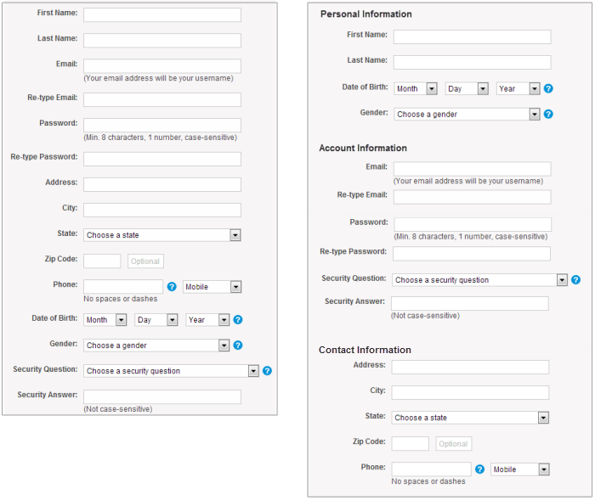
Structured Form

Slide 23
A Brief History of the Human – Computer Interaction
The lowest and the most common level of communication modes we share are movements and gestures.
The next higher level, in terms of universality and complexity, is spoken language.
At the third and highest level of complexity is written language.

Slide 24
Interaction Styles
Command Line Interface
Menus
Natural Language
Question/Answer and Query Dialogue
Form-Fills and Spreadsheets
WIMP
Point and Click
Three–dimensional interfaces

Slide 25
Brief History of Screen Design
1970’s Screen:
Contains many fields.
Cryptic and unintelligible captions
Visually clustered.
possessed a command field that challenged the user to remember what had to be keyed into it.
Ambiguous error message(often require manual)
Monochrmatic

Slide 26
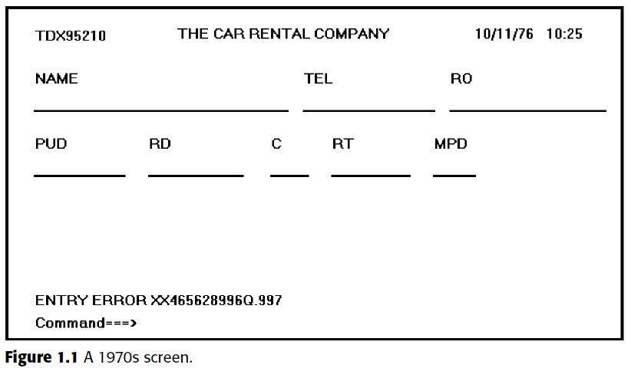
1970’s Screen

Slide 27
1980’s
less cluttered
Grouping and alignment of elements
Clear and meaningful captions
Commands were replaced by function keys.
Message became clear.

Slide 28
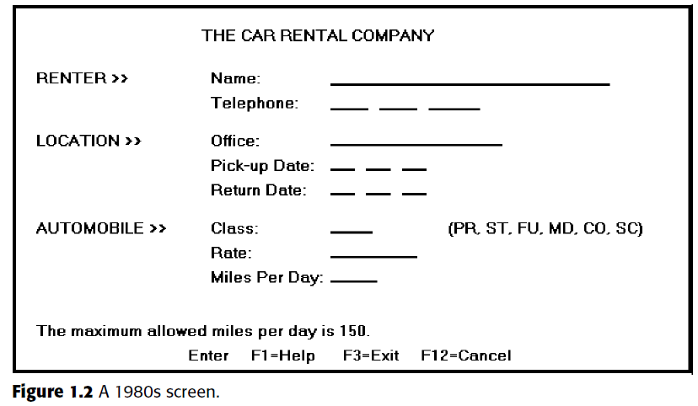
1980’s Screen

Slide 29
Advent of Graphics
Graphical Screens
groupings and alignment,
borders were made available.
buttons and menus for implementing commands replaced function keys.
font sizes and styles.
list boxes, drop-down combination boxes, spin boxes and many more

Slide 30
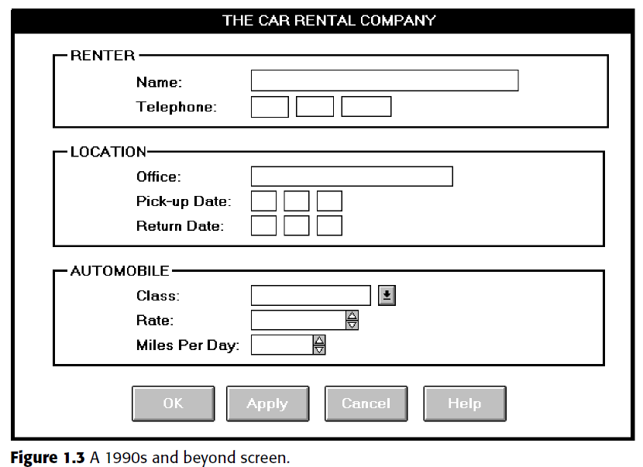
Graphical Screen

Slide 31
Characteristics of Graphical and Web User Interface
The Graphical User Interface – Definition
A user interface is a collection of techniques and mechanisms to interact with something.
In a graphical interface, the primary interaction mechanism is a pointing device. What the user interacts with, is a collection of elements referred to as objects.
They can be seen, heard, touched or otherwise perceived.
Objects are visible the user and are used to perform tasks.

Slide 32
Characteristics of Graphical and Web User Interface
They are interacted with as entities independent of all other objects.
People perform actions called actions on objects. The operations include accessing and modifying objects by pointing, selecting and manipulating.
All objects have standard resulting behaviors.

Slide 33
The Concept of Direct Manipulation
The term used to describe this style of interaction for graphical systems was first used by Shneiderman (1982)
These systems were called ‘direct manipulation’ and they possess the following characteristics
The system is portrayed as an extension of the real world
The system simply replicates the objects and actions and portrays them on the screen. A person has the power to access and modify these objects.
Continuous visibility of objects and actions
Objects are continuously visible. Nelson described this concept as ‘virtual reality’.
Hatfield called it WYSIWYG – What You See Is What You Get.

Slide 34
The Concept of Direct Manipulation
Actions are rapid and incremental with visible display of results
The results of actions are immediately displayed visually on the screen in their new and current form.
The impact of a previous action is quickly seen and the evolution of tasks is continuous and effortless.
Incremental actions are easily reversible
Actions, if discovered to be incorrect or not desired, can be easily undone.

Slide 35
Indirect Manipulation
Direct manipulation of all screen objects and actions may not be feasible because of the following
The operation may be difficult to conceptualize in the graphical system
The graphics capability of the system may be limited
The amount of space available for placing manipulation controls in the window border may be limited
It may be difficult for people to learn and remember all the necessary operations and actions
When this occurs, indirect manipulation is provided.

Slide 36
Indirect Manipulation
Indirect manipulation substitutes words and text, such as pull-down or pop-up menus, for symbols and substitutes typing for pointing.
Most window systems are a combination of direct and indirect manipulation.
A menu may be accessed by pointing at the menu icon and then selecting it (direct manipulation). The menu itself is a textual list of operations (indirect manipulation).

Slide 37
Graphical Systems : Advantages
Symbols recognized faster than text
Faster learning
More natural
Exploits visual/ spatial cues
Increased feeling of control
Immediate feedback
Predicate system responses
Easily reversible actions

Slide 38
Graphical Systems : Advantages
More attractive
May consume less space
Replaces national languages
Less typing requirements
Smooth transition from command language system

Slide 39
Graphical Systems : Disadvantages
Greater design complexity
Learning still necessary
Lack of experimentally-derived design guidelines
Inconsistencies in technique and terminology
Not always familiar
Human comprehension limitations
Production limitations

Slide 40
Graphical Systems : Disadvantages
Few tested icons exist
Inefficient for touch typists
Inefficient for expert users
Not always the preferred style of interaction
Not always fastest style of interaction
Increased chances of clutter and confusion
The futz and fiddle factor
May consume more screen space
Hardware limitations

Slide 41
Characteristics of the Graphical User Interface
A graphical system possesses a set of defining concepts.
Some of them are
Sophisticated Visual Presentation
Pick-and-Click Interface
A Restricted Set of Interface Options
Visualization
Object Orientation
Extensive Use of a Person’s Recognition Memory
Concurrent Performance of Functions

Slide 42
Sophisticated Visual Presentation
Visual presentation is the visual aspect of the interface. It is what the people see in the screen.
The meaningful interface elements visually presented to the user in a graphical system include
Windows (Primary, Secondary or Dialog boxes)
Menus (Menu bar, pull-down, pop-up, cascading)
Icons to represent objects such as programs or files,
Assorted Screen-based controls (text boxes, combination boxes, settings, scroll bars, buttons)
Mouse pointer, Cursor

Slide 43
Pick-and-Click Interaction
Pick is the term used to describe the activity required by a person to identify the element for a proposed action.
The signal to perform an action is called click.
The primary mechanism for performing this pick-and-click is most often the mouse and its buttons.
The eye, hand and mind seem to work smoothly and efficiently together.
The secondary mechanism for performing selection actions is the keyboard.

Slide 44
Restricted Set of Interface Options
The alternatives available to the user is what is presented on the screen or what may be retrieved through what is presented on the screen, nothing less, nothing more.
This concept is referred as WYSIWYG (What You See Is What You Get).

Slide 45
Visualization
It is a process that allows people to understand information that it is difficult to perceive, because it is either too voluminous or too abstract.
It involves changing an entity’s representation to reveal the structure and/or function of the underlying system or process.
The best visualization method for an activity depends on what people are trying to learn from the data.

Slide 46
Object Orientation
A graphical system consists of objects and actions. Objects are what people see on the screen. They are manipulated as a single unit.
A well-designed system keeps users focused on objects, not on how to carry out actions.
Objects can be composed of subobjects.
For example, an object can be a document. The documents subobjects may be paragraphs, sentences, words and letters.

Slide 47
3 classes of objects
Data objects
Container objects
Device objects

Slide 48
Data Objects
Data objects present information.
This information, either text or graphics, normally appears in the body of the screen.
It is essentially the screen-based controls for information collection or presentation organized on the screen.

Slide 49
Container Objects
Container objects are objects to hold other objects.
They are used to group two or more related objects for easy access and retrieval.
There are three kinds of container objects
Workplace is the desktop, the storage area for all objects.
Folders are general-purpose containers for long-term storage of objects.
Workareas are temporary storage folders used for storing multiple objects currently being worked on.

Slide 50
Device Objects
They represent physical objects in the real world such as printers or trash buckets.
These objects may contain others for acting upon. A file for example, may be placed in a printer for printing of its contents.
Objects can exist within the context of other objects, and one object may affect the way another object appears or behaves.

Slide 51
Properties or Attributes of Objects
Objects also have properties or attributes.
Properties are the unique characteristics of an object.
They help to describe an object and can be changed by users.
Examples are text styles, font sizes or window background colors.

Slide 52
Actions
In addition to objects are actions. People take actions on objects. They manipulate objects in specific ways or modify the properties of objects.
Commands are actions that manipulate objects. They may be performed in a variety of ways including direct manipulation or through a command button.
They are executed immediately when selected. Once executed, they cease to be relevant. Examples of commands are opening a document, printing a document, closing a window and quitting an application.

Slide 53
Actions
Property/Attribute specification actions establish or modify the attributes or properties of objects. When selected, they remain in effect until deselected.
Examples include selecting cascaded windows to be displayed, a particular font size or a particular color.
The following is a typical property/attribute specification sequence:
The user selects an object
The user then selects an action to apply to that object
The selected words are made bold and will remain bold until selected and changed again
A series of actions may be performed on a selected object. Performing a series of actions on an object also permits and encourages system learning through exploration

Slide 54
Use of Recognition Memory
Continuous visibility of object’s and actions encourages use of a person’s more powerful recognition memory.
The ‘out of sight, out of mind problem is eliminated.

Slide 55
Concurrent Performance of Functions
Graphical systems may do two or more things at one time. Multiple programs may run simultaneously.
When the system is not busy on a primary task, it may process background tasks (cooperative multitasking).
When applications are running separate tasks, the system may divide the processing power into time slices and allocate portions to each application (preemptive multitasking).

Slide 56
The Web User Interface
Web interface design is essentially the design of navigation and the presentation of information. It is about content, not data.
Proper interface design is a matter of balancing the structure and relationships of menus, content and other linked documents or graphics.
The design is to build a hierarchy of menus and pages that feel natural, is well structured, is easy to use and is truthful.
The Web is a navigation environment where people move between pages of information, not an application environment. It is also a graphically rich environment.

Slide 57
The Web User Interface
Reasons for difficulty in Web interface design
It underlying design language, HTML, was never intended for creating screens to be used by the general population.
Its scope of users was expected to be technical.
HTML was limited in objects and interaction styles and did not provide a means for presenting information in the most effective way for the people.
Browser navigation retreated to the pre-GUI era. It was characterized by a ‘command’ field whose contents had to be learned.
GUIs eliminated the absolute necessity for a command field, providing menus related to the task.

Slide 58
The Web User Interface
Browser navigation is mostly confined to a “Back” and “Forward” concept, but back-to-where or forward-to-where is unknown.
Ill-timed use of the back button can destroy many minutes of the work.
Numerous links were produced to the destinations unknown
Form completion and submission was essentially a form of batch processing.
Forms were completed, transmitted and then edited instead of the editing being interactive, occurring as the entry process was accomplished.

Slide 59
Popularity of the Web
It allows millions of people across the globe to communicate, access information, publish and be heard.
It allows people to control the display and rendering of Web pages.
Slow download times, confusing navigation, confusing page organization, disturbing animation and other undesirable features are some of the disadvantages of the Web pages.

Slide 60

Characteristics of a Web Interface
GUI versus Web Page Design
Both designs have similarities.
Both are software designs
They are used by people
They are interactive
They are heavily visual experiences presented through screens
They are composed of many similar components.

Slide 61
Significant Differences of GUI and Web Page Design
1.Devices:
In GuI design,the characteristics of the interface devices such as monitors and modem are well defined and screens appear exactly as specified.
In Web design,the user devices may range from handheld mechanism to the high end work stations,it will be generated by both the hardware and the software.
2.User Focus:
GUI systems are normally well defined applications and the data about transactions and processes.
Web is all about information and navigation.
3.Data and Information:
In GUI system the data is created and used by known and trusted sources.
The web is full of unknown content and web content is highly variable in organizations.

Slide 62
Significant Differences of GUI and Web Page Design
4.User Tasks:
In GUI ystems,the user can install,configure,personalize,start use and upgrade the programs and people become familiar with many of its feature.
Web Users do linking to sites,browsing or reading the pages,filling out forms,register for services participating in transactions,downloading and saving the pages,etc.,
5.User's Conceptual Space:
In GUI,the user's conceptual space is controlled by the program and application.
In Web,the user's space is infinite and generally unorganized.
6.Navigation:
The GUI,the users navigate through structured menus,lists,trees,dialogs and wizards.
The Web users navigate through links,bookmarks and typed URLS.

Slide 63
Significant Differences of GUI and Web Page Design
7.Context:
GUI systems enable the users to maintain a better sense of context and the restricted navigation paths.
Web Pages are single entities with almost unlimited navigation paths.
8.Response Time:
GUI response time is nearly instantaneous.
In Web it depends on the transmission speeds,page content and so on.
9.System Capability:
GUI system capabilities are only limited to the capability of hardware and the sophistication of software.
Web is more constrained,being limited by constraints imposed by hardware,software and the browser.

Slide 64
Significant Differences of GUI and Web Page Design
10.Task Efficiency:
GUI system are targeted to a specific audience performing specific task,efficiency of performing task is only limited.
Web systems tasks limited by the browser and the network.Websites are intended for everyone.
11.Security:
In GUI environment,security and data access can be tightly controlled in proportion to the willingness to invest resources and effort.
Web is renowned for security exposures,browser-provided security options have not been well understood by the average web users.
12.User Assistance:
In GUI,the user assistance is an integral part of the most GUI applications,this assistance is accessed through the standard mechanism and help menus.
In Web,it cannot provide with the help system.

Slide 65
Principles of User Interface Design
The interface should serve as both a connector and a separator.
A connector is that it ties the user to the power of the computer.
A separator is that it minimizes the possibility of the participants damaging one another.

Slide 66

General Principles
Aesthetically Pleasing
Clarity
Compatibility
Comprehensibility
Configurability
Consistency
Control
Directness
Efficiency
Familiarity
Flexibility
Forgiveness
Predictability
Recovery
Responsiveness
Simplicity
Transparency

Slide 67
Aesthetically Pleasing
Provide visual appeal by following these presentation and graphic design principles.
Provide meaningful contrast between screen elements
Create groupings
Align screen elements and groups
Provide three-dimensional representation
Use color and graphics effectively and simply

Slide 68
Grouping
Billing details:
Name
Address: …
credit card no
Delivery details:
Name
Address: …
delivery time
Order details:
Item quantity cost/item cost
Size 10 screws (boxes) 7 3.71 25.97
…… … … …
ABCDEFGHIJKLM
NOPQRSTUVWXYZ
Sherbert 75 Toffee 120 Chocolate 35 Fruit gums 27 Coconut dreams 85
Sherbert 75 Toffee 120 Chocolate 35 Fruit gums 27 Coconut dreams 85
Sherbert 75 Toffee 120 Chocolate 35 Fruit gums 27 Coconut dreams 85

Slide 69
Clarity
The interface should be visually, conceptually and linguistically clear including,
Visual elements
Functions
Metaphors – is a mapping process from a familiar object to an unfamiliar object and provides the framework to familiarize an unknown concept through a mapping process.
Words and text

Slide 70
Compatibility
Provide compatibility with the following
The user
The task and job
The product
Adopt the user’s perspective

Slide 71
Comprehensibility
A system should be easily learned and understood. A user should know the following
What to look at
What to do
When to do it
Where to do it
Why to do it
How to do it
The flow of actions, responses, visual presentations and information should be in a sensible order that is easy to recollect and place on context.

Slide 72
Configurability
Permit easy personalization, configuration, and reconfiguration of settings
Enhances a sense of control
Encourages an active role in understanding

Slide 73
Consistency
A system should look, act and operate the same throughout. Similar components should
Have a similar look
Have similar uses
Operate similarly
The same action should always yield the same result
The function of elements should not change
The position of standard elements should not change

Slide 74
Control
The user must control the interaction
Actions should result from explicit user requests
Actions should be performed quickly
Actions should be capable of interruption or termination
The user should never be interrupted for errors

Slide 75
Directness
Provide direct ways to accomplish tasks
Available alternatives should be visible
The effect of actions on objects should be visible

Slide 76
Efficiency
Minimize eye and hand movements, and other control actions
Transitions between various system controls should follow easily and freely
Navigation paths should be as short as possible
Eye movement through a screen should be obvious and sequential
Anticipate the user’s wants and needs whenever possible

Slide 77
Familiarity
Employ familiar concepts and use a language that is familiar to the user
Keep the interface natural, mimicking the user’s behavior pattern
Use real-world metaphors

Slide 78
Forgiveness
Tolerate and forgive common and unavoidable human errors
Prevent errors from occurring whenever possible
Protect against possible catastrophic errors
When an error does occur, provide constructive messages

Slide 79
Recovery
A system should permit
Commands or actions to be abolished or reversed
Immediate return to a certain point if difficulties arise
Ensure that users never lose their work as a result of
An error on their part
Hardware, software or communication problems

Slide 80
Simplicity
Provide as simple an interface as possible
Five ways to provide simplicity
Use progressive disclosure, hiding things until they are needed
Present common and necessary functions first
Prominently feature important functions
Hide more sophisticated and less frequently used functions
Provide defaults
Minimize screen alignment points
Make common actions simple at the expense of uncommon actions being made harder
Provide uniformity and consistency

Slide 81
Transparency
Permit the user to focus on the task or job, without concern for the mechanics of the interface
Workings and reminders of workings inside the computer should be invisible to the user

